Slide 1







CLIMATE CARE
The urgent call to action
Green planet

Slide 2



TEAM
01 - Het patel
02 - Jay Parekh
03 - Sai Suraj
04 - Rohith Varma

Slide 3

01 - WHAT IS IT?
Welcome to the Climate Care application – your digital companion in the journey towards a more sustainable future. Our platform is dedicated to those who are concerned about climate change and eager to make a positive impact. Through a blend of education, awareness, and action, we empower individuals and communities to become proactive environmental stewards. Let's dive into the features that make Climate Care a unique tool in the fight against climate change

Slide 4
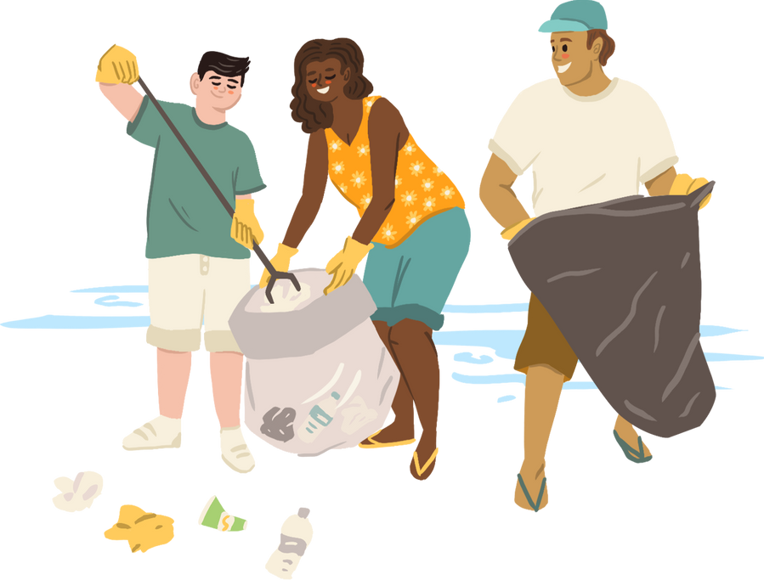
TECHNOLOGIES USED
React
Express JS
Material UI
NodeJS
Mongo DB

Slide 5
CARBON CALCULATOR
UNDERSTANDING YOUR CARBON FOOTPRINT IS THE FIRST STEP TOWARDS REDUCING IT. OUR CARBON CALCULATOR ALLOWS USERS TO GAUGE THEIR PERSONAL IMPACT ON THE ENVIRONMENT BASED ON DAILY HABITS SUCH AS FOOD CONSUMPTION AND MODES OF TRANSPORTATION.

Slide 6
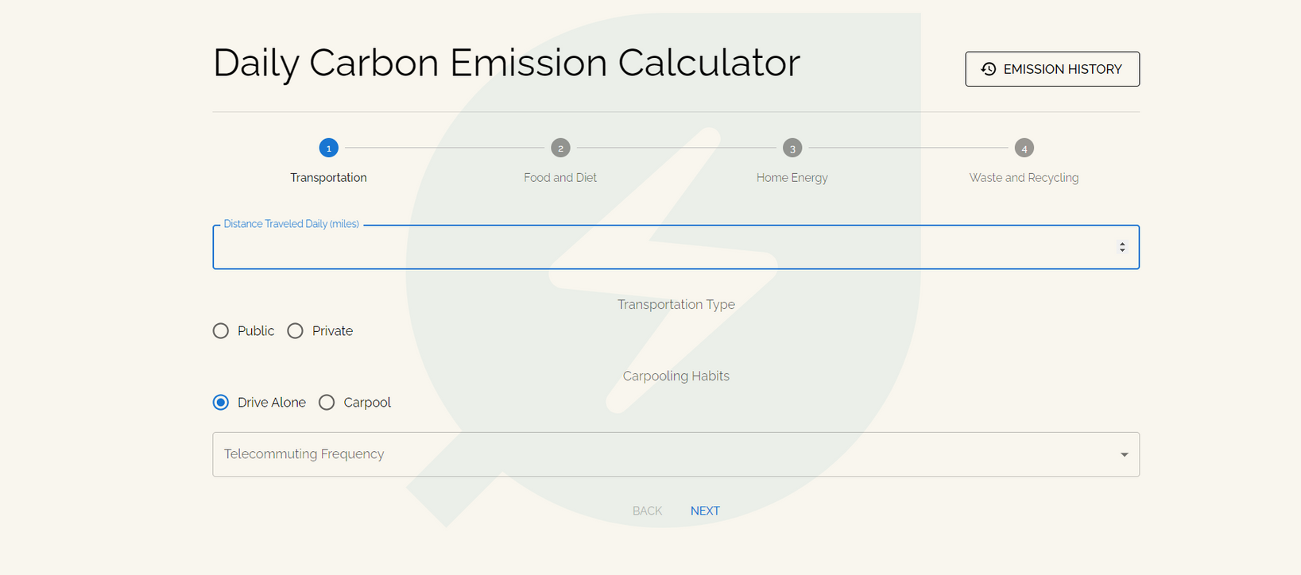

Slide 7
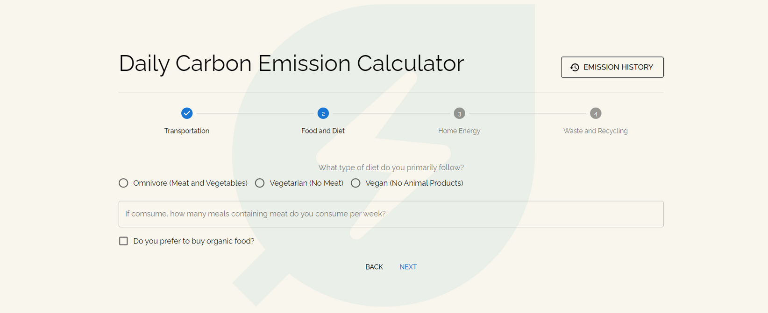

Slide 8
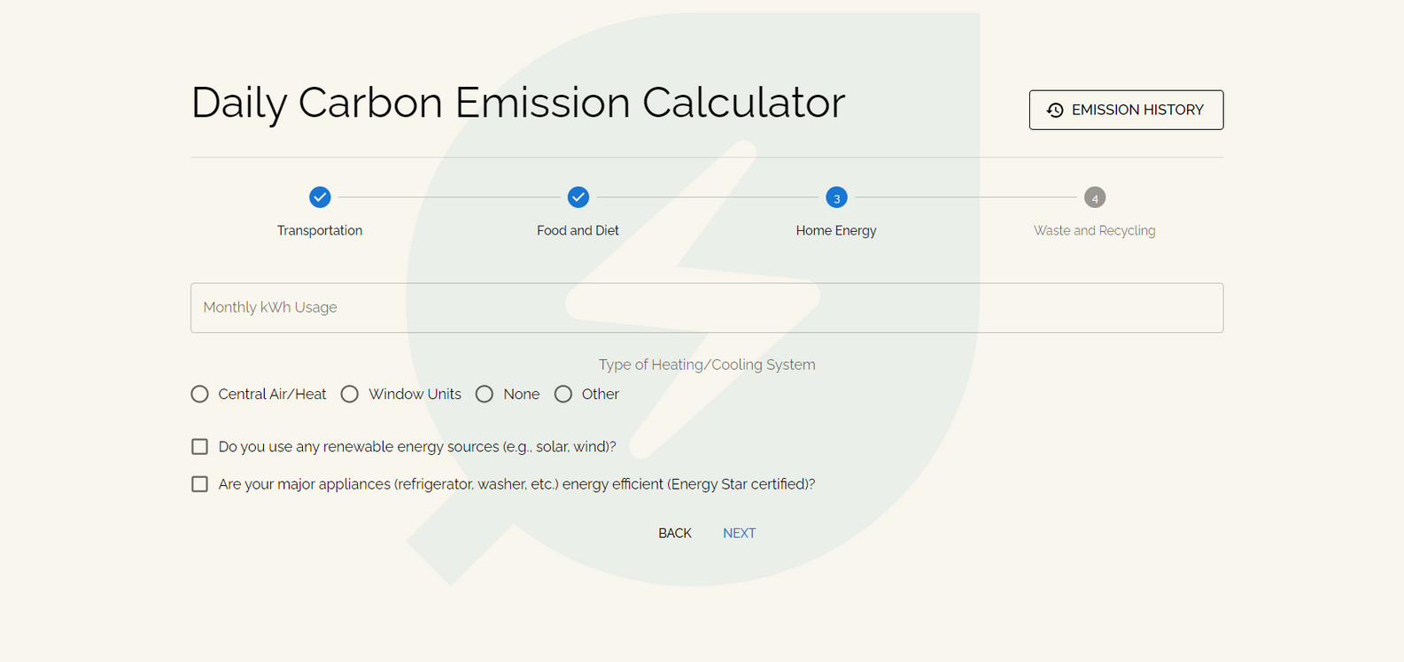

Slide 9
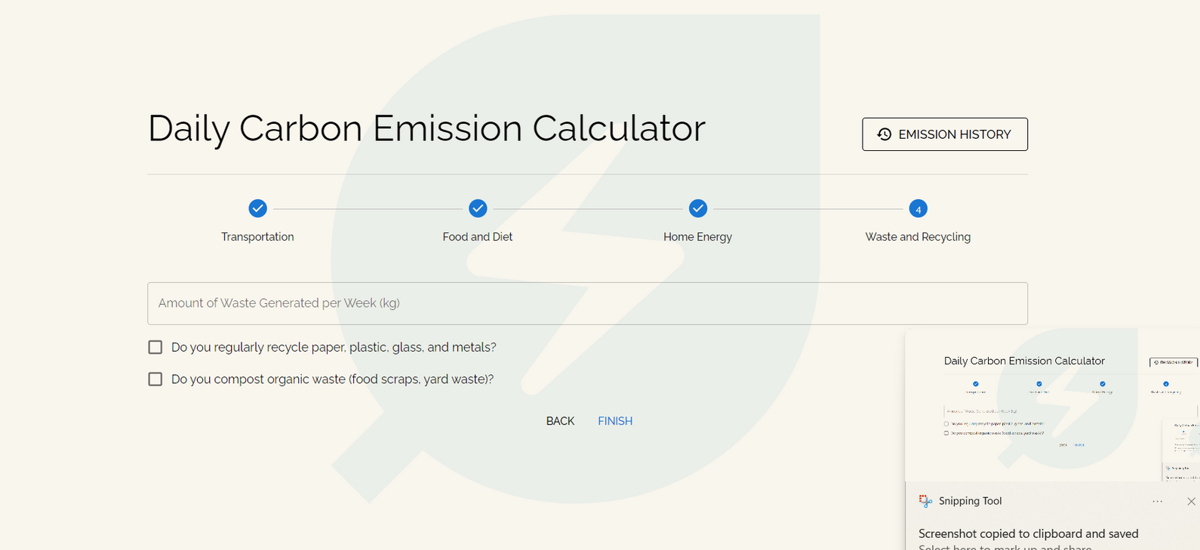

Slide 10

EVENTS MANAGEMENT
Renewable energy
Get involved in environmental events and initiatives ranging from beach cleanups to campaigns against single-use plastics. Our platform enables both individuals and NGOs to engage with and organize events, fostering a community of active participants in the cause of climate preservation.

Slide 11
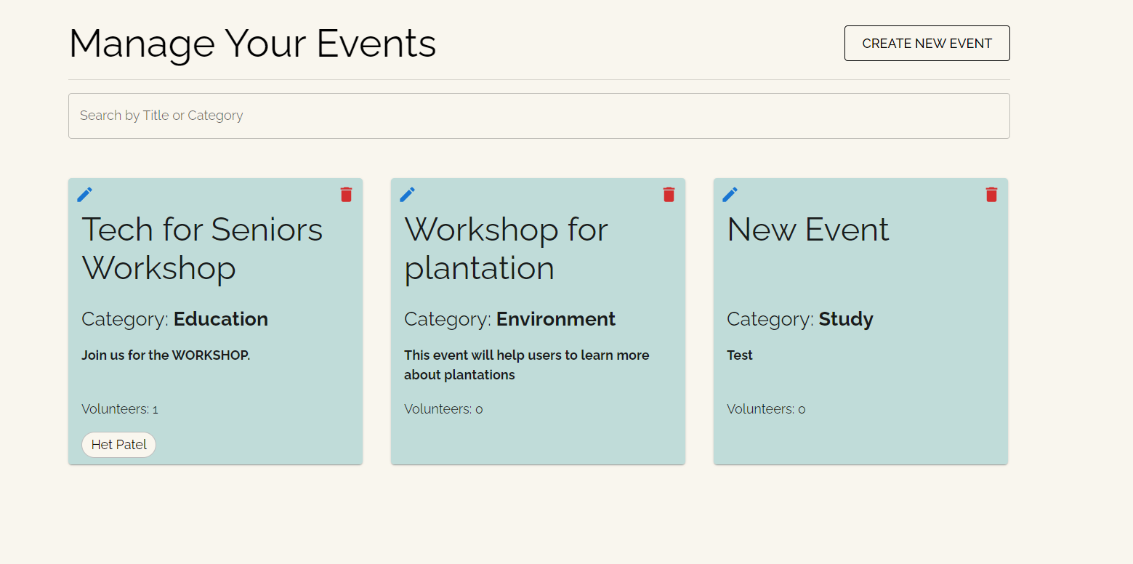

Slide 12
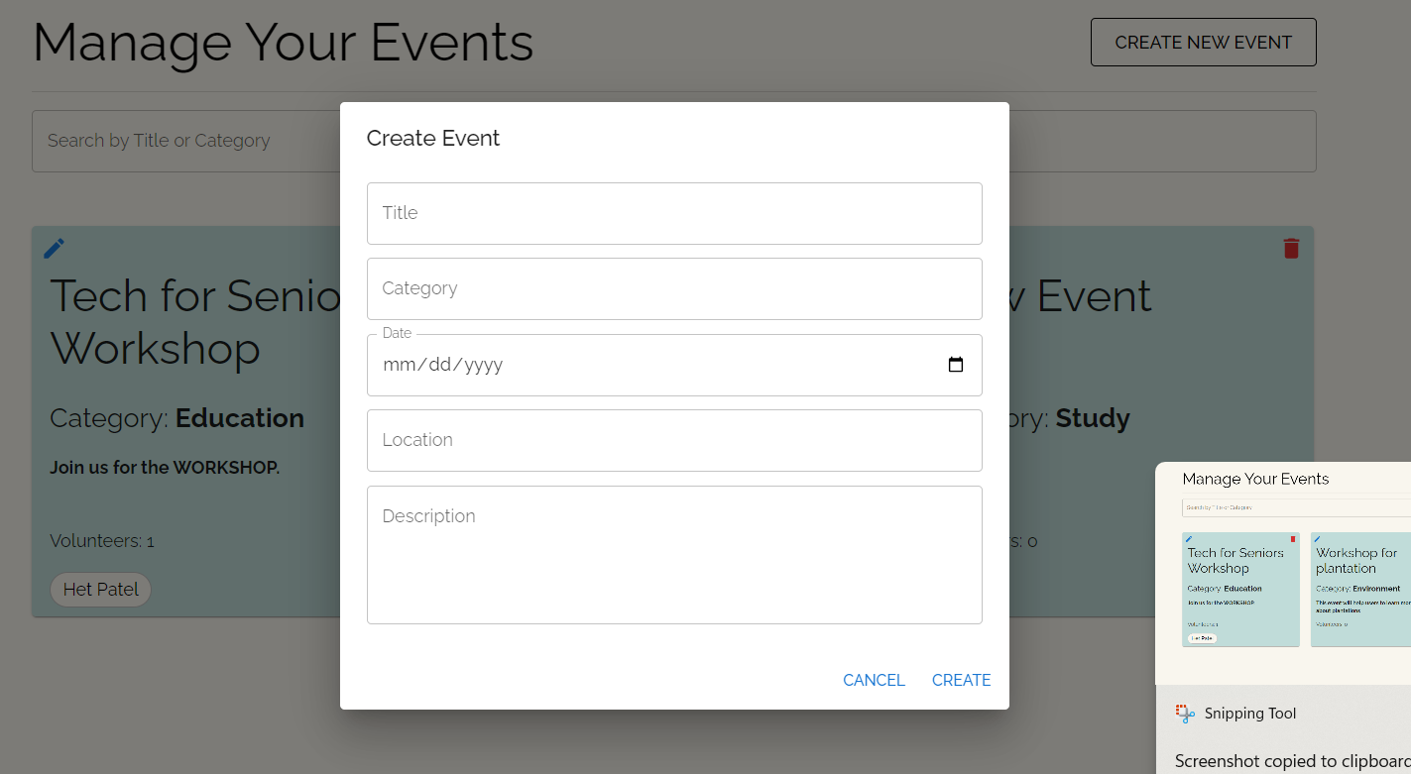

Slide 13

USER AND AUTHENTICATION
To offer a personalized experience, Climate Care supports user registration and authentication. Securely log in to access and customize your environmental journey.
Addressing the climate change challenge

Slide 14
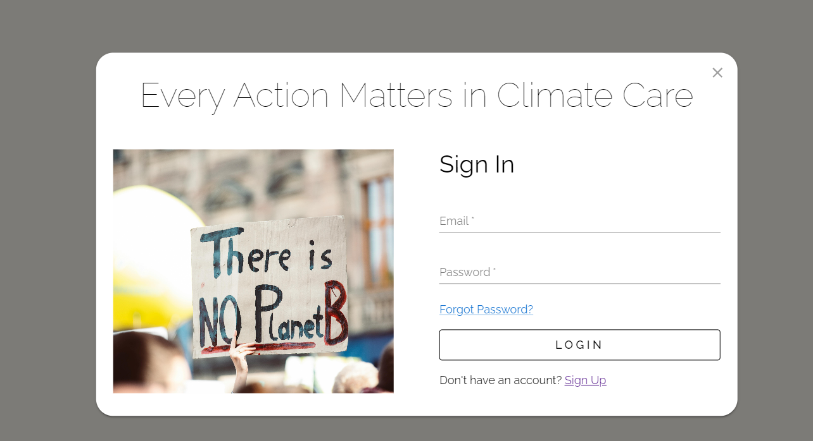

Slide 15
EDUCATIONAL RESOURCES
Here users can learn and get to know about the climate change. here we are providing awarenes by showing the images, videos and educational articles
Addressing the climate change challenge

Slide 16
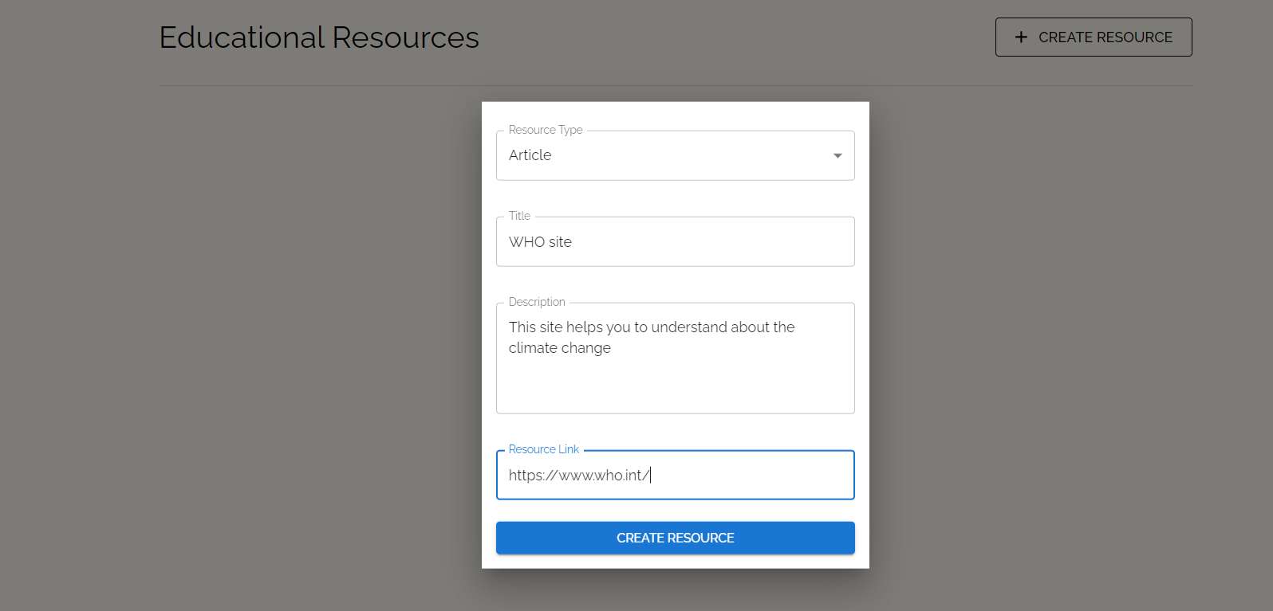

Slide 17
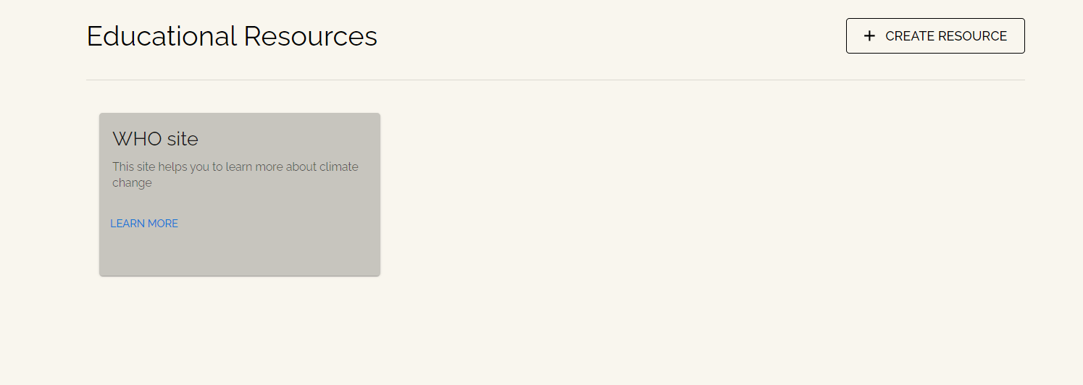

Slide 18


DEMO

Slide 19
THANKS

